Slide 1
User Experience Design Tool
UI/UX DESIGN

Slide 2
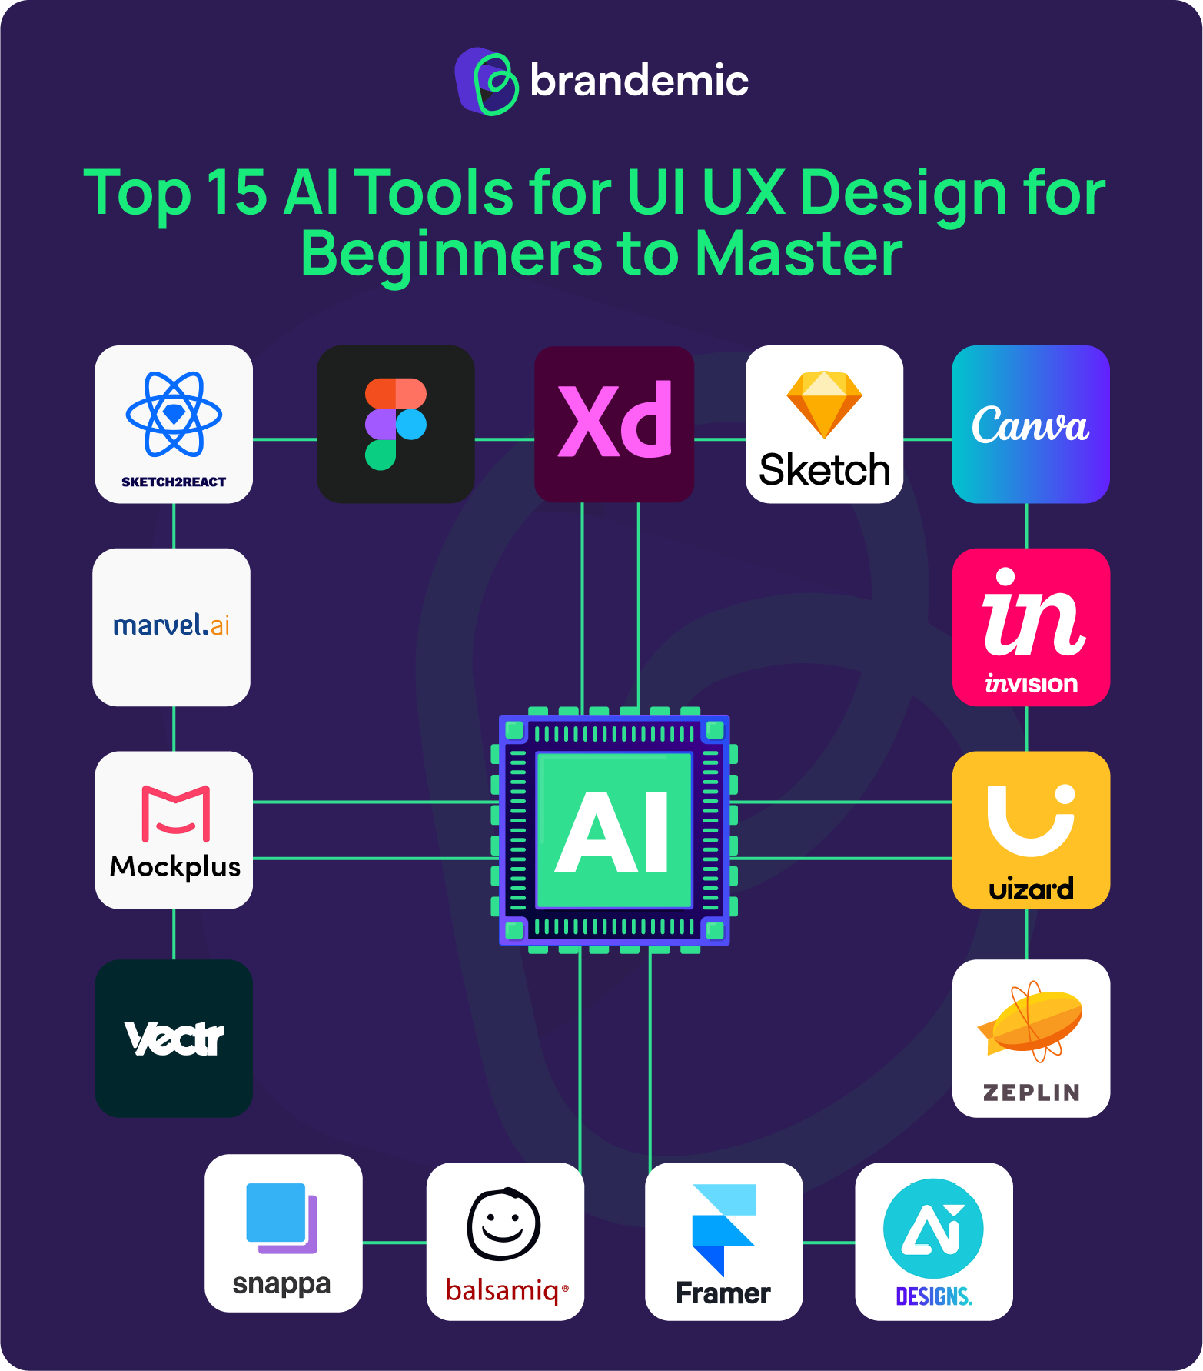

Slide 3
1. OVERVIEW:
The core concept of user experience design is that users use interfaces to accomplish a task. This idea is going to be central to the way we approach the course. That is, in understanding the user and the task they want to accomplish, we'll be able to design the best interface.
User experience (UX) design is the process design teams use to create products that provide meaningful and relevant experiences to users.
UX design involves the design of the entire process of acquiring and integrating the product, including aspects of branding, design, usability and function.

Slide 4
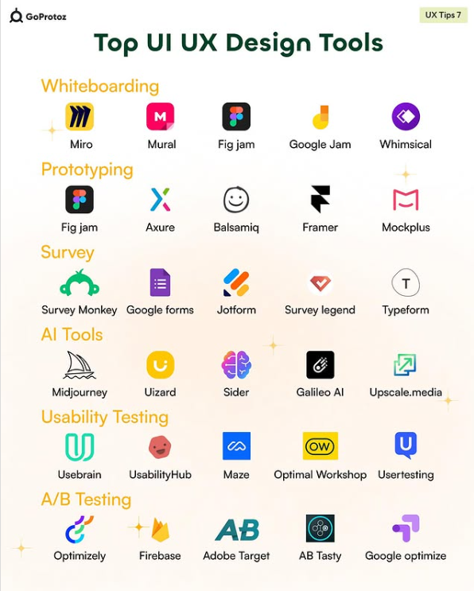

Slide 5
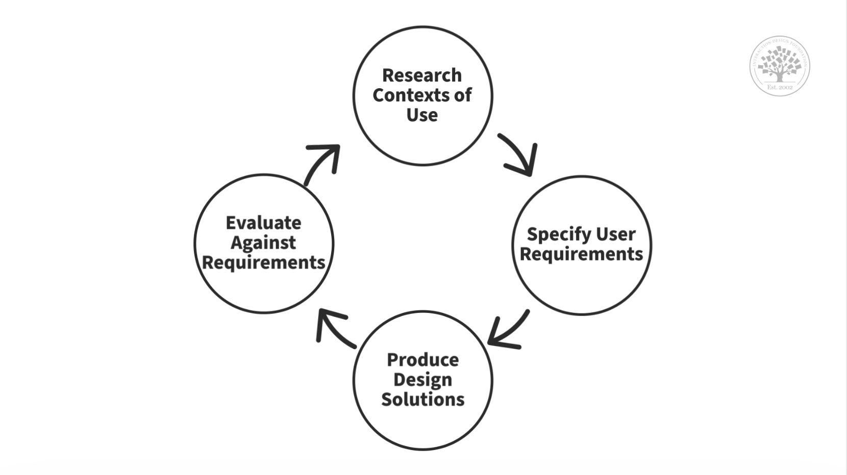
2. UX Design is User-Centered:
Since UX design encompasses the entire user journey, it’s a multidisciplinary field–UX designers come from various backgrounds, such as visual design, programming, psychology and interaction design. To design for human users also means working with a heightened scope regarding accessibility and accommodating many potential users’ physical limitations, such as reading small text.

Slide 6
3. Open Source UX Design Tools Similar to Figma::
Penpot
UXPin
Moqups
Uizard
Marvel
UI and UX design is an important part of any product. With growing technical needs, designers and designing tools also evolve. Figma is the most popular UI/ UX design tool available right now, but there are several alternative software available like Penpot, UXPin, Moqups and more.

Slide 7
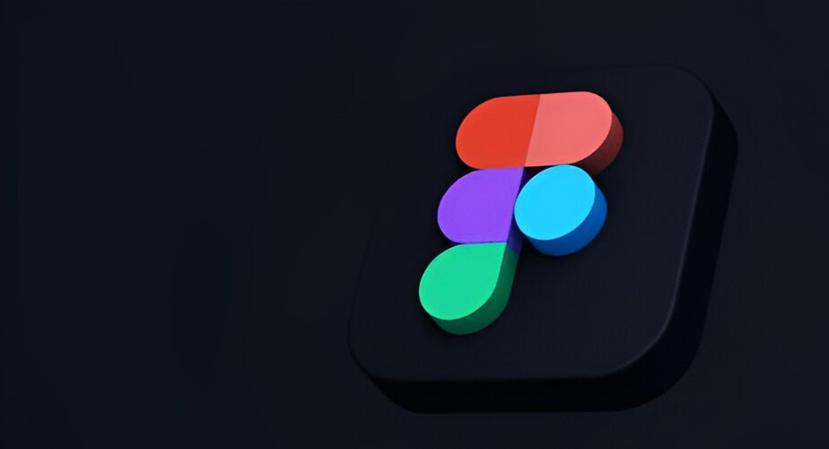

Slide 8
Key Features in UX Design Tools
Navigations:
Navigation refers to the methods and UI components that help users move between different screens, pages, or sections of a product.
Interactions:
Interactions refer to the dynamic behaviour of UI components when users interact with them (e.g., clicking, hovering, or swiping).
Buttons:
Buttons are interactive elements used for performing actions (e.g., Submit, Cancel, Next).

Slide 9
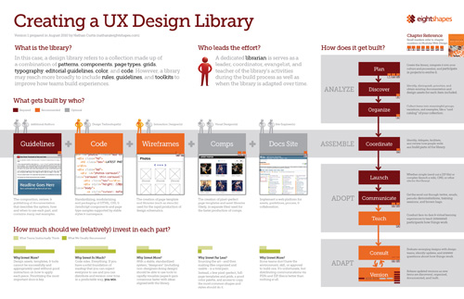
5. Creating a Library in UX Design Tools
Steps to Create:
Define Core Elements:
Design Components:
Organize into Categories:
Share the Library:

Slide 10
Example Open-Source Tools Supporting These Features:
1. Penpot:
Fully open source and web-based.
Supports prototyping with navigations and interactions.
Allows creating libraries for consistent design.
2. Lunacy:
Lightweight desktop app with collaboration features.
Includes pre-made libraries for buttons and navigation.
3. Akira:
Designed specifically for Linux users.
Focused on interface and interaction design.

Slide 11
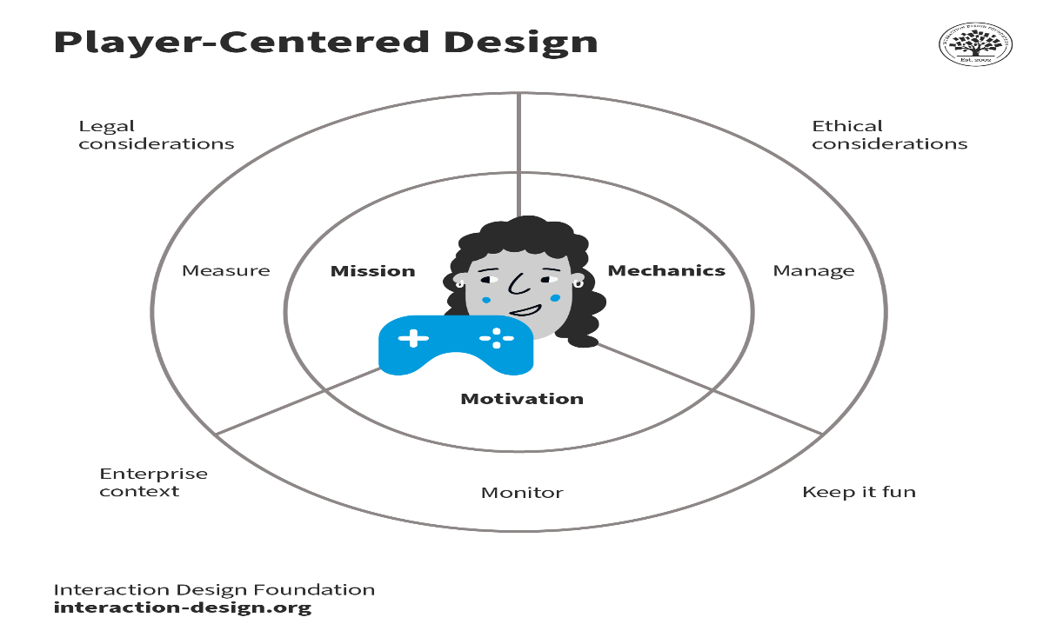
Gamification with Animation
Gamified elements are known for enhancing
user engagement by making tasks like
onboarding or daily check-ins fun and
competitive. If you add game-like animated
design elements every time users accomplish
something, you can make UX even more fun.
Gamification is a powerful tool to drive user
engagement. The goal is not to transform
user interfaces into games. Instead, designers
should inject fun elements into applications and systems that might otherwise lack immediacy or relevance for users.

Slide 13
6. Key Components of Gamification

Slide 14
Key Components of Gamification
Points: A way to measure performance and progress
Leaderboards: A way to rank performance and encourage competition
Progress bars: A way to show how close a user is to completing a task or goal
Levels: A way to track performance by setting parameters like leveling up after completing a requirement
Rewards: A way to encourage desired behaviors by providing tangible incentives
Challenges: A way to provide hope and motivation by offering a chance of a better outcome
Badges: A way to recognize achievement
Timers: A way to set time limits
Stories: A way to add context and narrative
Social engagement: A way to encourage collaboration and participation

Slide 15
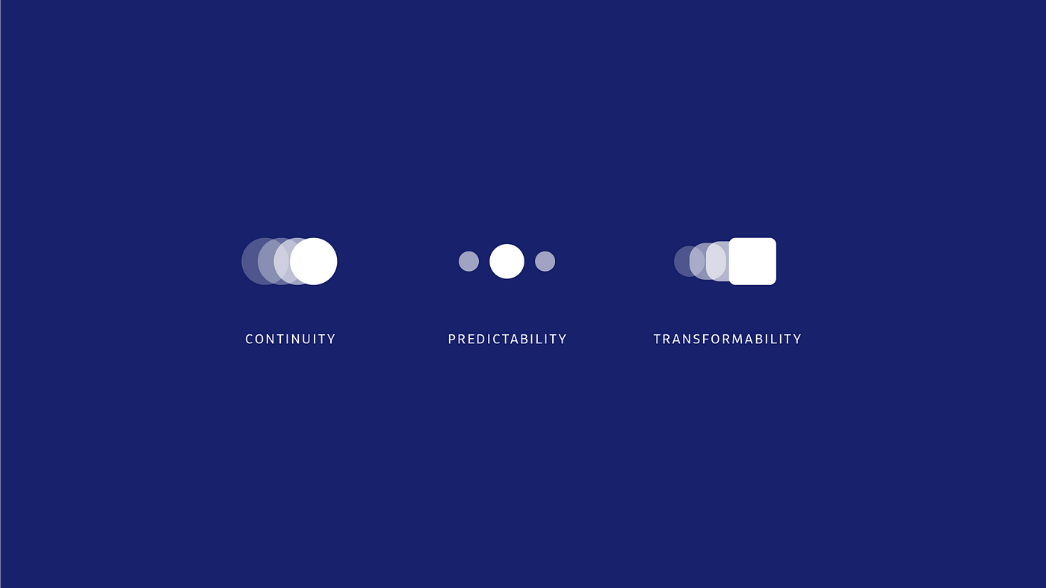
Micro-animation
Small, subtle animations used in user interfaces to enhance the user experience and provide visual feedback.

Slide 16
Common Types:
Button animations: Add visual feedback when buttons are clicked
Icon animations: Bring icons to life and make them more interactive
Loading animations: Indicate that a process is ongoing
Transition animations: Make transitions between screens or elements smoother
Hover animations: Highlight elements when the user hovers over them
Error animations: Provide visual feedback when an error occurs

Slide 17
8. • Combining Gamification and Micro-animation
Gamification can be enhanced by using micro-animations to add visual appeal, feedback, and motivation.
Micro-animations can be used to gamify interfaces by adding points, levels, badges, and other game-like elements.
This combination can create a more engaging and immersive user experience that leads to increased user engagement, motivation, and productivity.

