Slide 1
User Interface Design
UI/UX DESIGN

Slide 2
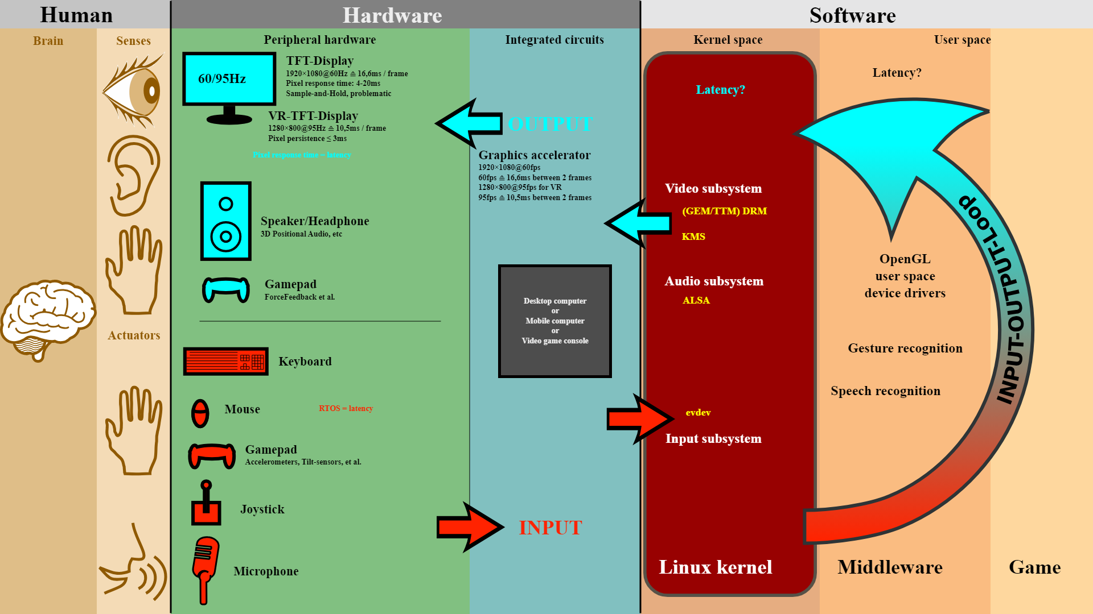

Slide 3
1. OVERVIEW:
User interface (UI) design is the process of creating interfaces for software or devices that are easy to use and visually appealing. UI designers create interfaces for graphical user interfaces, voice-controlled interfaces, and more.

Slide 4
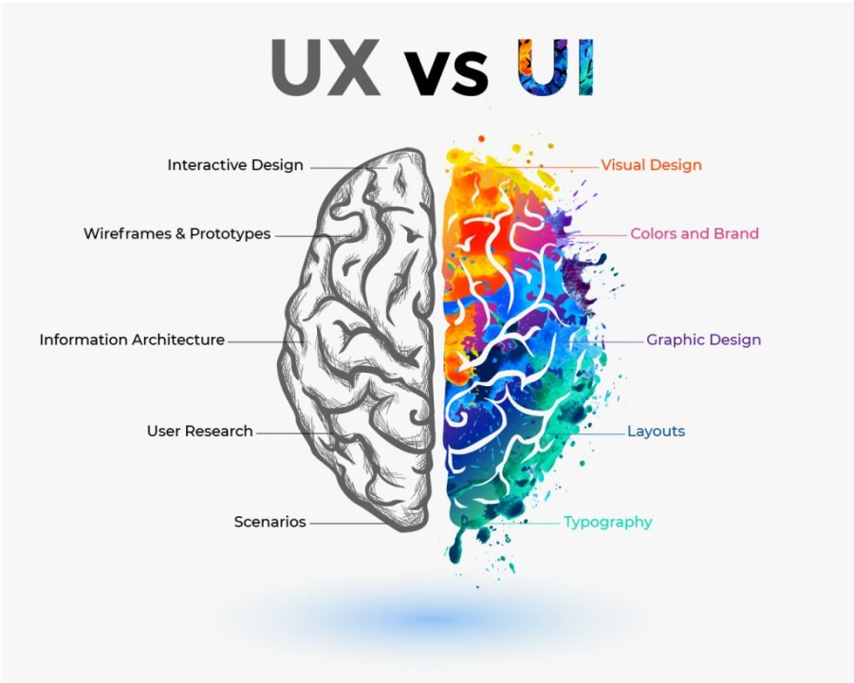

Slide 5
2. PRINCIPLES OF UI DESIGN:
• Control: Users should be in control of the interface.
• Consistency: Use common elements to make the interface predictable and easy to navigate.
• Comfort: Interacting with the product should be comfortable and effortless
• Cognitive load: Be clear and concise, and avoid bombarding users with content.
• Accessibility: Ensure the interface is usable by people with diverse abilities.

Slide 7
3. STORYBOARDING:
Storyboarding is a visual representation of a user's journey through a product or service, helping designers map out and refine the user experience.
We will delve into the significance of storyboards in UI/UX design and how they contribute to creating exceptional digital experiences

Slide 9
THE ROLE OF STORYBOARD IN UI/UX Design
One of the primary benefits of storyboarding is its ability to identify potential usability issues early in the design process. By visually mapping out the user’s interactions, designers can anticipate pain points, discover areas for improvement, and make informed design decisions.
Storyboards provide a tangible way to explore different scenarios and user paths, enabling designers to identify and address any hurdles or bottlenecks that users may encounter.

Slide 10
5. USER JOURNEY MAPPING:
User journey mapping is a technique in user interface (UI) and user experience (UX) design that helps designers understand how users interact with a product.
It's a visual representation of the user's experience, from their first awareness of a product to after they've purchased it.
This map helps designers see the entire user experience, allowing them to identify pain points and opportunities for improvement.

Slide 11
Key Components of User Journey Mapping
• User Personas: Detailed profiles representing different user types.
• Touchpoints: Specific interactions users have with the product.
• User Goals: The objectives users aim to achieve at each stage.
• Emotions: The feelings users experience throughout their journey.
• Pain Points: Challenges or frustrations users encounter.
• Opportunities: Areas where the user experience can be improved

Slide 12
STEPS TO CREATE A USER JOURNEY MAP
Steps:
Identifying User Personas:
Mapping Out User Touchpoints:
Visualizing User Interactions:
Analyzing User Emotions:
5. Identifying Pain Points and Opportunities:

Slide 13
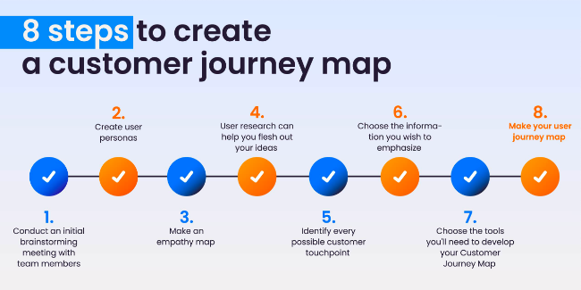

Slide 14
6. GESTALT PRINCIPLES OF DESIGN

Slide 15
GESTALT PRINCIPLES OF DESIGN
Proximity

Slide 16
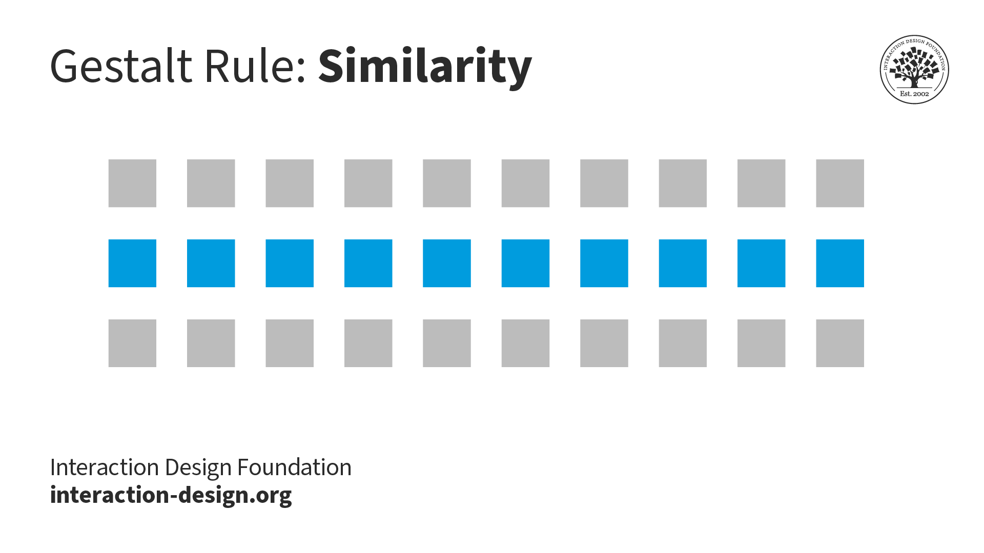
GESTALT PRINCIPLES OF DESIGN
Similarity

Slide 17
GESTALT PRINCIPLES OF DESIGN
• Figure and ground:

Slide 18
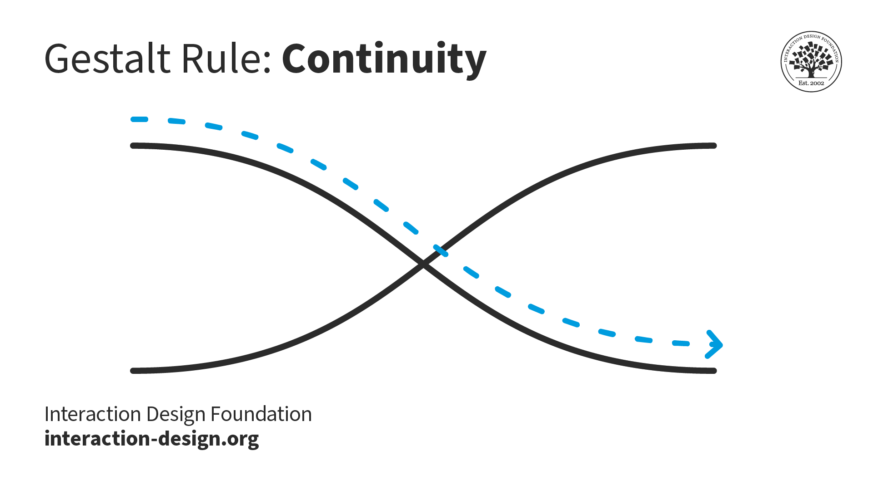
GESTALT PRINCIPLES OF DESIGN
Continuity

Slide 19
GESTALT PRINCIPLES OF DESIGN
• Symmetry

Slide 20
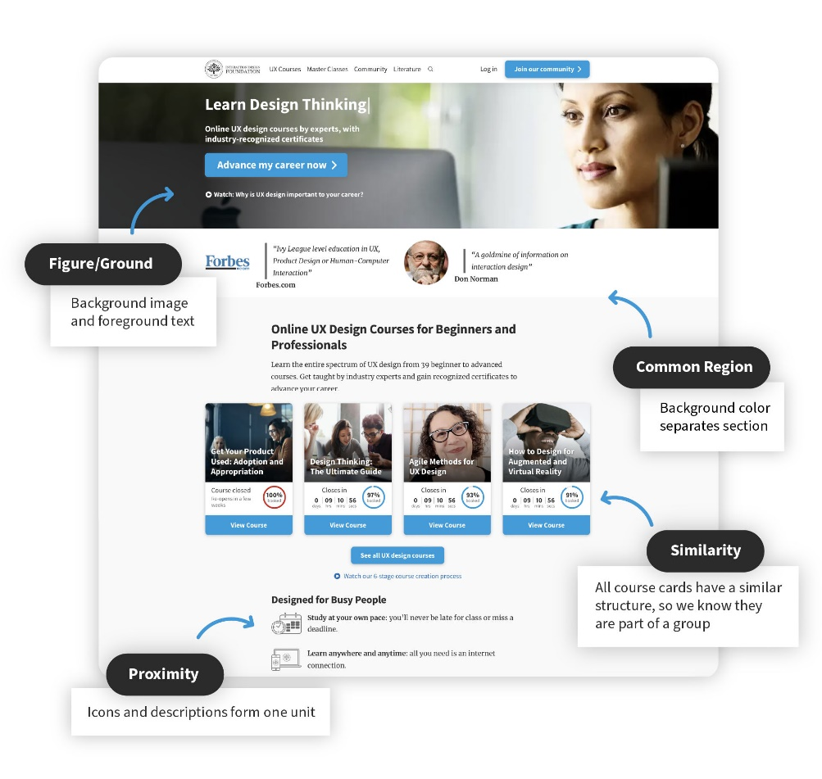
GESTALT PRINCIPLES OF DESIGN
• • Simplicity

Slide 21
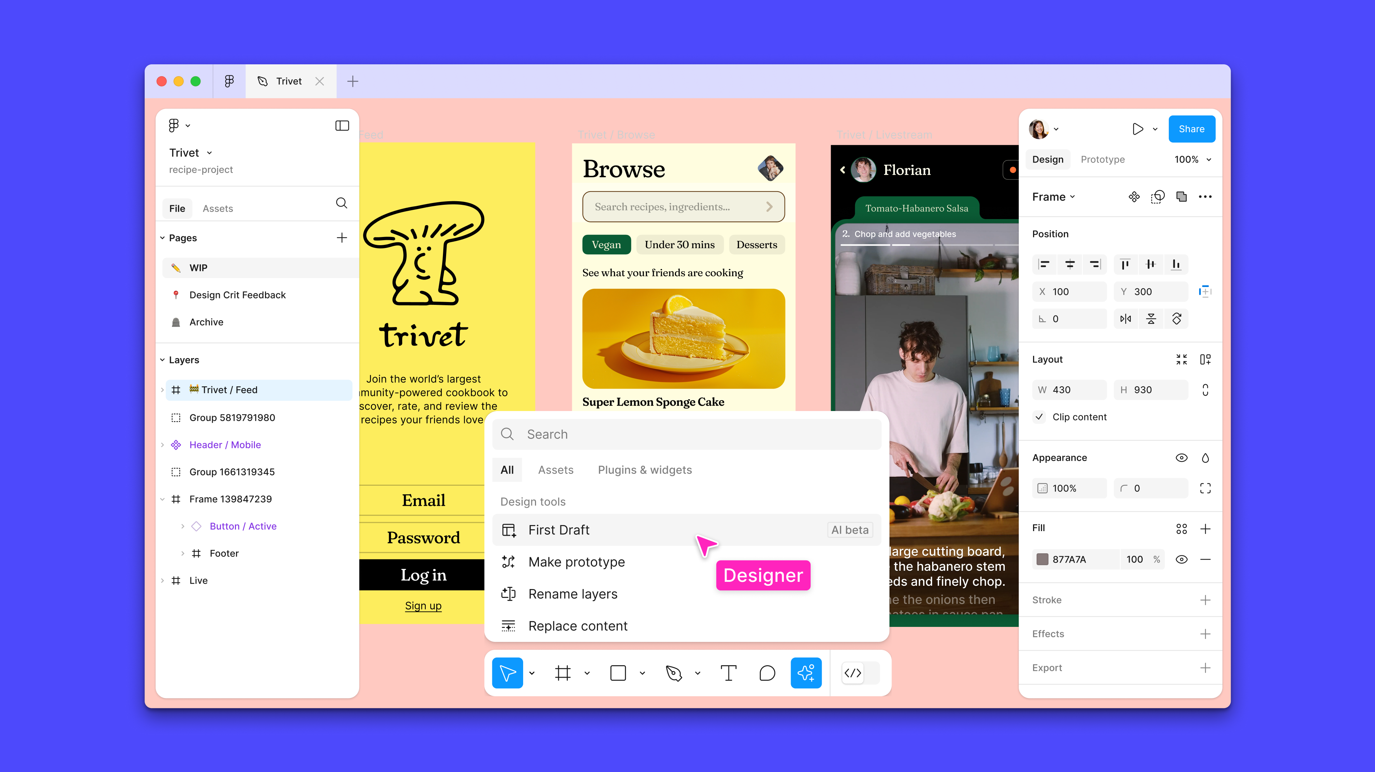
Figma
Figma is a free, web-based design tool that allows users to create, share, and test designs for websites, mobile apps, and other digital products. It's a popular tool for designers, product managers, writers, and developers.

Slide 22
Features of figma
• Collaboration: Allows users to work together in real time on the same file
• Prototyping: Allows users to create interactive prototypes without writing code
• Design systems: Allows users to standardize styles, components, and variables across products and brands
• Feedback: Allows users to get contextual feedback from stakeholders in real time
• Sharing: Allows users to share designs, templates, and widgets with others
• Scalability: Allows users to scale edits instantly and automatically adjust designs to layout size.

Slide 23
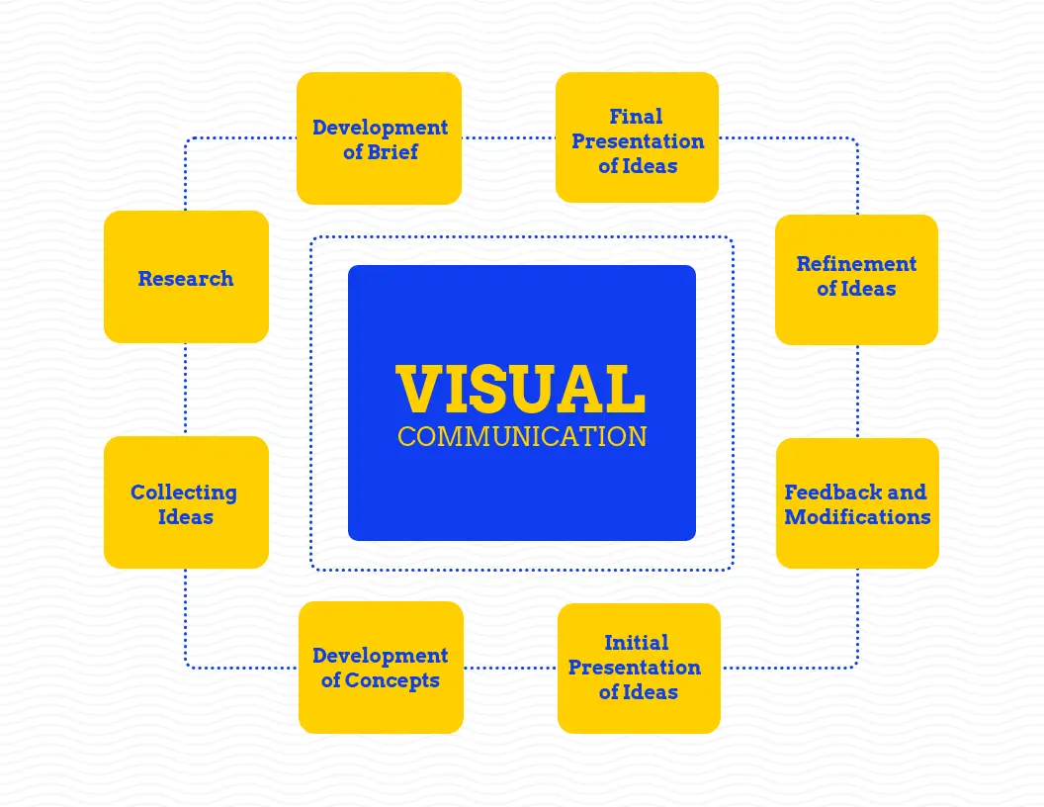
8. VISUAL COMMUNICATION DESIGN
Effective visual communication for graphical user interfaces (GUIs) involves using visual elements to convey information in a way that's clear, consistent, and engaging.

Slide 24
Principles of effective visual communication
• Color: Use color to guide the viewer's eye, create visual hierarchy, and evoke emotions.
• Hierarchy: Arrange information in a visual hierarchy so that the most important information is communicated first.
• Consistency: Use the same design elements throughout the interface, such as colors, typography, and button styles.
• Simplicity: Remove unnecessary elements to avoid clutter.
• Feedback: Use visual cues to inform users about the outcome of their actions.
• Flexibility: Allow users to customize their experience.
• Efficiency: Enable quick and smooth navigation.

Slide 25
Elements of visual communication
• Text: Use typefaces, font sizes, and spacing to ensure readability.
• Images: Use relevant images to improve storytelling and create mood.
• Shapes: Use shapes and lines to outline processes and flows.
• Icons: Use icons to create more memorable information.
• Data visualizations: Use data visualizations to show the impact of your work.
Technologies that can improve visual communication Augmented reality (AR) and Virtual reality (VR).

