Slide 1
User Requirements and its Analysis
UI/UX DESIGN

Slide 2
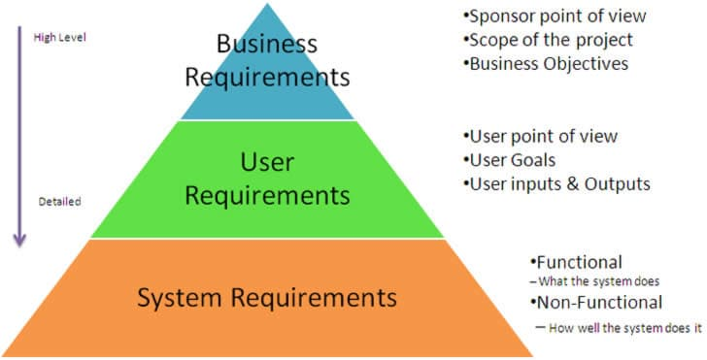

Slide 3
FigJam Introduction
FigJam is a collaborative online whiteboard tool for brainstorming and planning.
Key Features:
- Collaborative Environment
- Easy Integration
- Templates and Stickers
- Cross-Platform
- Freeware

Slide 4
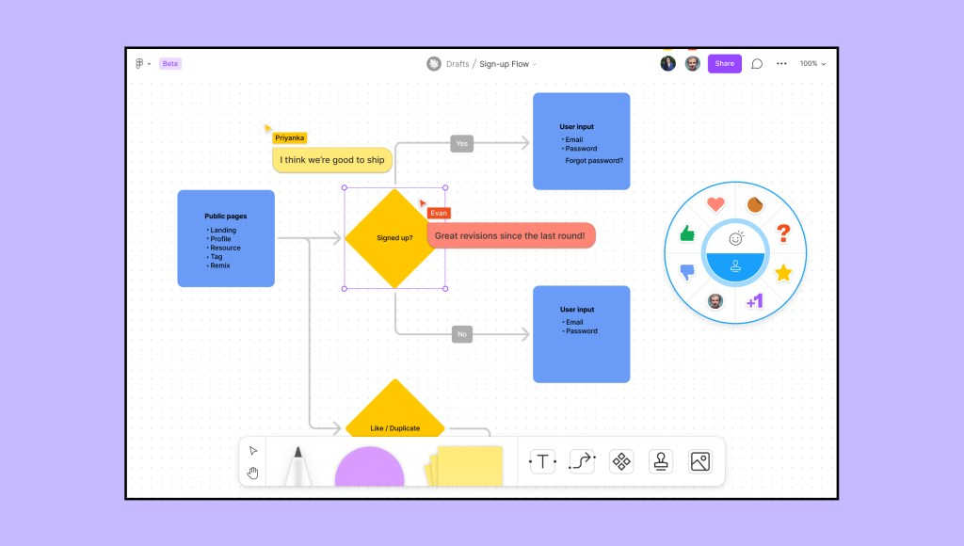

Slide 5
FigJam Applications
- Brainstorming sessions
- Mind mapping
- Project planning
- Retrospectives and feedback sessions

Slide 6
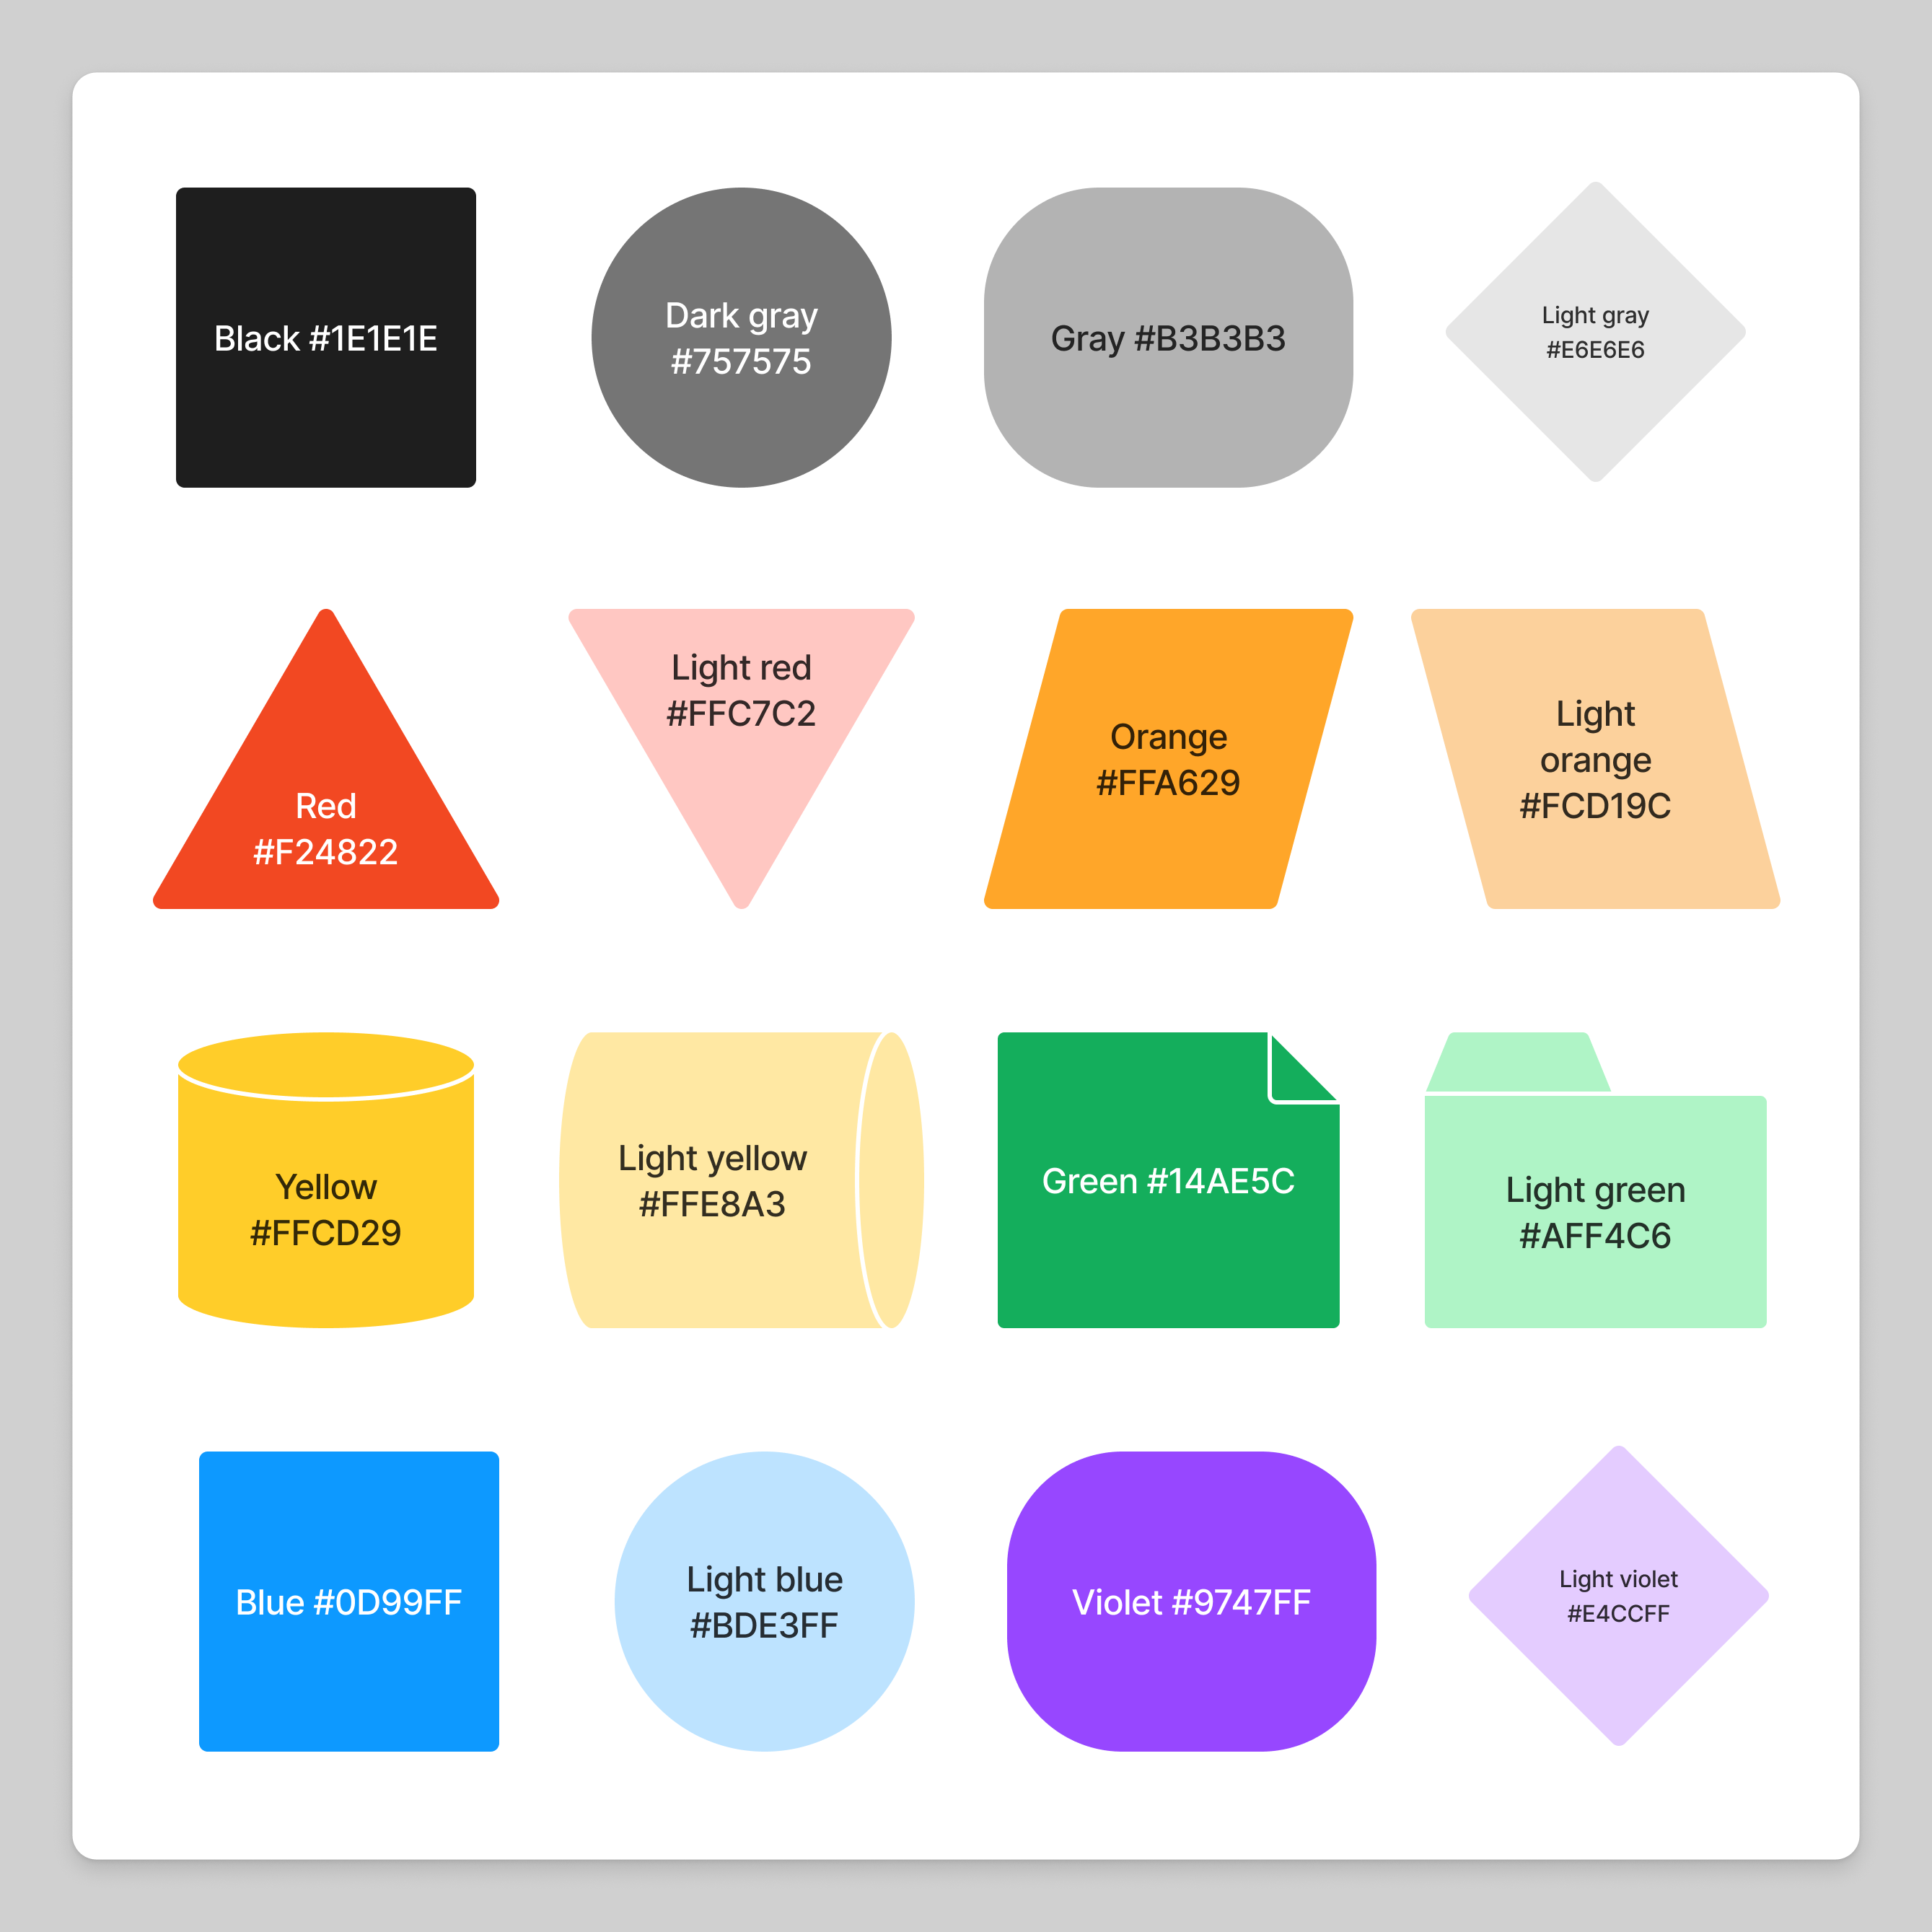

Slide 7
User Requirements
Definition:
User requirements are the needs and expectations of end-users.
They guide the development process to meet user expectations.

Slide 9
Types of User Research
1. Qualitative Research:
- Personal Observation
- Interviews
- User/Expert Reviews
2. Quantitative Research:
- Questionnaires
- Metrics and Analytics

Slide 10
Tools for Collecting User Requirements
- Personal Observation
- Interviews
- Questionnaires
- User/Expert Reviews

Slide 11
Understanding Target Audience
- Gather demographic information.
- Identify user behaviors and expectations.
- Align with client requirements.

Slide 12
Competitive Analysis
Steps:
1. Identify key competitors.
2. Analyze features, feedback, and positioning.
3. Identify unique selling points and improvement areas.

Slide 13
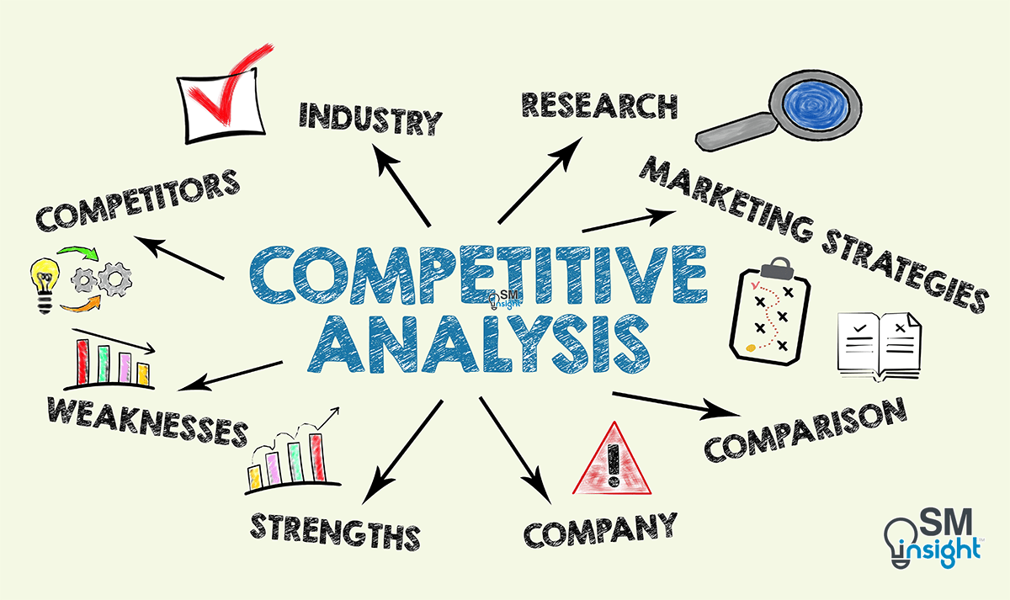

Slide 14
Affinity Mapping
Method:
- Collect data.
- Write on sticky notes.
- Group similar ideas.
- Label groups with descriptive headings.

Slide 15
User Persona
Components:
- Demographics
- Goals
- Pain Points
- Behavior Patterns
- Motivations
Steps:
1. Gather data.
2. Identify common characteristics.
3. Develop persona profiles.
4. Use personas for design decisions.

Slide 16
History of UX
Don Norman coined 'User Experience' in the 1990s at Apple.
Roots in human-computer interaction, ergonomics, and industrial design.
Evolved into a multidisciplinary field.

Slide 17
UI & UX
Need for UI:
- Engaging, easy-to-navigate interfaces.
- Consistent branding.
Need for UX:
- Meets user needs.
- Enhances satisfaction.
- Reduces frustration and increases loyalty.

Slide 18
Why UI & UX Are Essential?
- Ensure user satisfaction.
- Seamless and enjoyable experiences.
- Enhance retention and loyalty.

Slide 19
Conclusion
Understanding and analyzing user requirements is essential for creating meaningful designs.
UI & UX principles ensure user satisfaction and engagement.

