Slide 1
UNIT 3 Vectors & Tensors
MATHEMATICS FOR MACHINE LEARNING

Slide 2
Vectors and Tensors
A vector is a mathematical quantity that has both magnitude and direction. Vectors are used in physics, engineering, and machine learning to represent various physical quantities like force, velocity, and displacement.

Slide 3
VECTORS
Properties of Vectors
Magnitude: The length of the vector, denoted as |A|.
Direction: The angle the vector makes with a reference axis.
Components: A vector can be broken into components along the x, y, and z axes.

Slide 4
INTRODUCTION
• Scalars: Quantities with magnitude only
• Vectors: Quantities with magnitude and direction
• Applications in physics, engineering, and AI

Slide 5
Definition of Scalars and Vectors
• Scalar: Only magnitude (e.g., mass, time, temperature)
• Vector: Magnitude + direction (e.g., displacement, velocity, force)

Slide 6
Representation of a Vector
• Represented by arrows
• Length: Magnitude
• Arrowhead: Direction
Direction Ratios and Cosines
• Direction ratios: Proportional to components
• Direction cosines: cos(α), cos(β), cos(γ) with axes

Slide 7
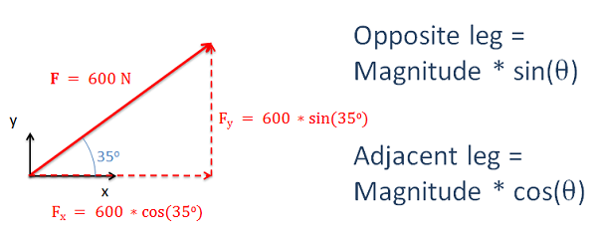
Magnitude and Components of a Vector
• Magnitude formula: |A| = √(x² + y² + z²)
• Components along x, y, z axes

Slide 8
Types of Vectors
Zero Vector: A vector with zero magnitude.
Unit Vector: A vector with a magnitude of one.
Position Vector: Represents a point’s position in space.
Equal Vectors: Vectors that have the same magnitude and direction.
Negative Vector: A vector pointing in the opposite direction of another vector.

Slide 9
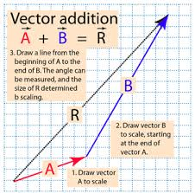
Vector Addition
• Triangle Law: A + B = Resultant
• Parallelogram Law: Diagonal represents resultant

Slide 10
Vector Subtraction & Scalar Multiplication
• Subtraction: A - B = A + (-B)
• Scalar Multiplication: Changes magnitude, keeps direction

Slide 11
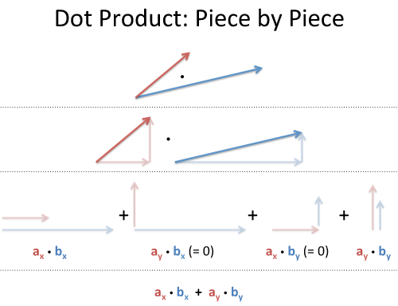
Dot Product of Vectors
• Formula: A·B = |A||B|cosθ
• Applications: Angle between vectors, projections

Slide 12
Cross Product of Vectors
• Formula: A × B = |A||B|sinθ n̂
• Result is perpendicular to both vectors

Slide 13
Scalar Triple Product
• Formula: A · (B × C)
• Represents volume of parallelepiped

Slide 14
Definition of Tensors
• Generalization of scalars, vectors, and matrices
• Transforms under coordinate changes

Slide 15
Types and Rank of Tensors
• Scalars (0th-order), Vectors (1st-order), Matrices (2nd-order)
• Higher-order tensors used in AI & physics

Slide 16
Applications of Tensors
• Physics: Stress & strain tensors, relativity
• Engineering: Material properties, fluid dynamics
• AI/ML: Deep learning frameworks like TensorFlow

