Slide 1
Unit. No. 3c Angle, Screw thread Gear & Surface finish measurement
By :- Prof. Y. J. Potdar
Mechanical Engineering Department
YTC, Satara

Slide 2
Introduction to Gears
Gears are mostly used for transmission of power and motion. They are used in various automobiles, machines, equipments, electronic systems etc.
Gears are used for decreasing speed & increasing speed.
Various gears are used for various purposes.
Spur gears are cylindrical gears whose tooth traces are straight lines.
Helical gears are of straight helices.
Spiral gears has tooth traces with curved lines.
Bevel gears are those which generates a cone with the help of tooth traces.
The gears with non-parallel and non-intersecting axes are generally worm gears.

Slide 3
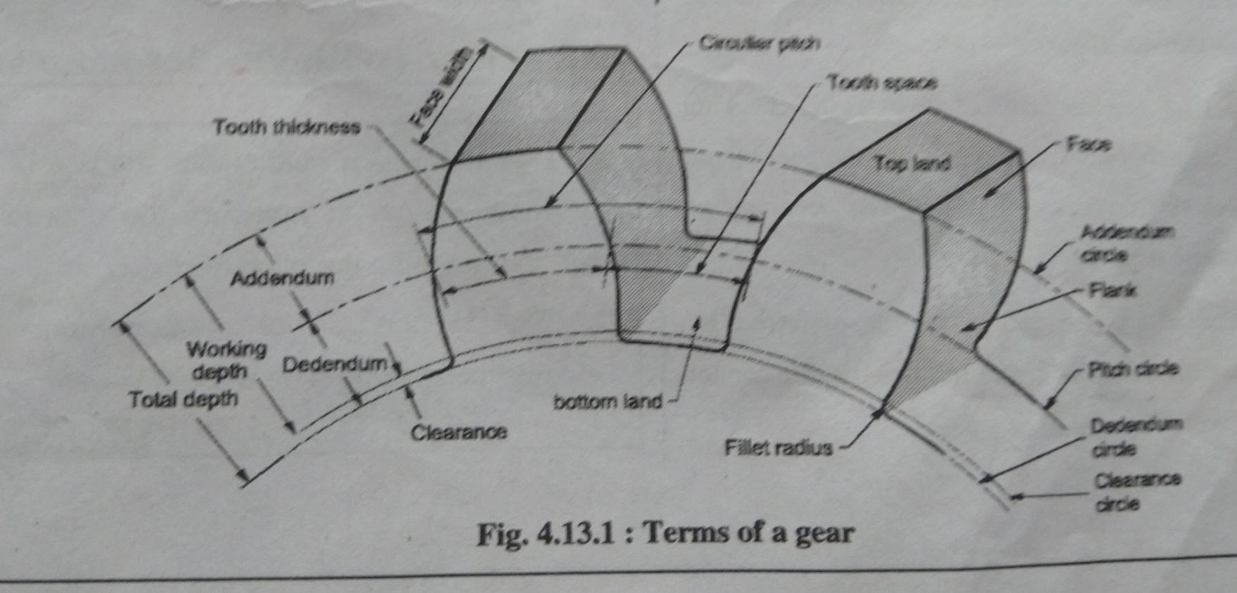
Introduction to Gears

Slide 4
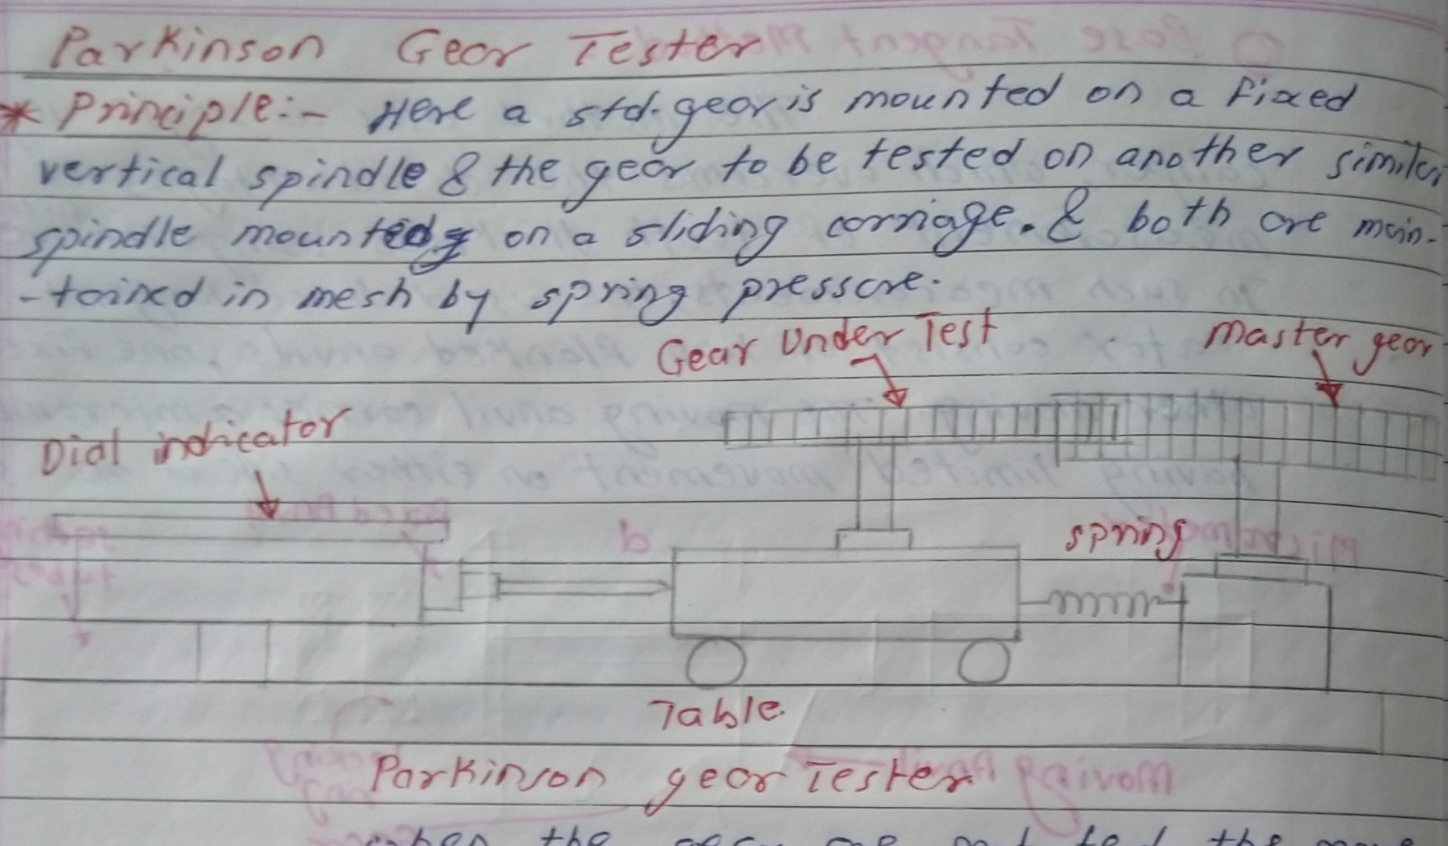
3.3a Measurement of Tooth Thickness by
Parkinson Gear Tester

Slide 5

3.3a Measurement of Tooth Thickness by
Parkinson Gear Tester

Slide 6
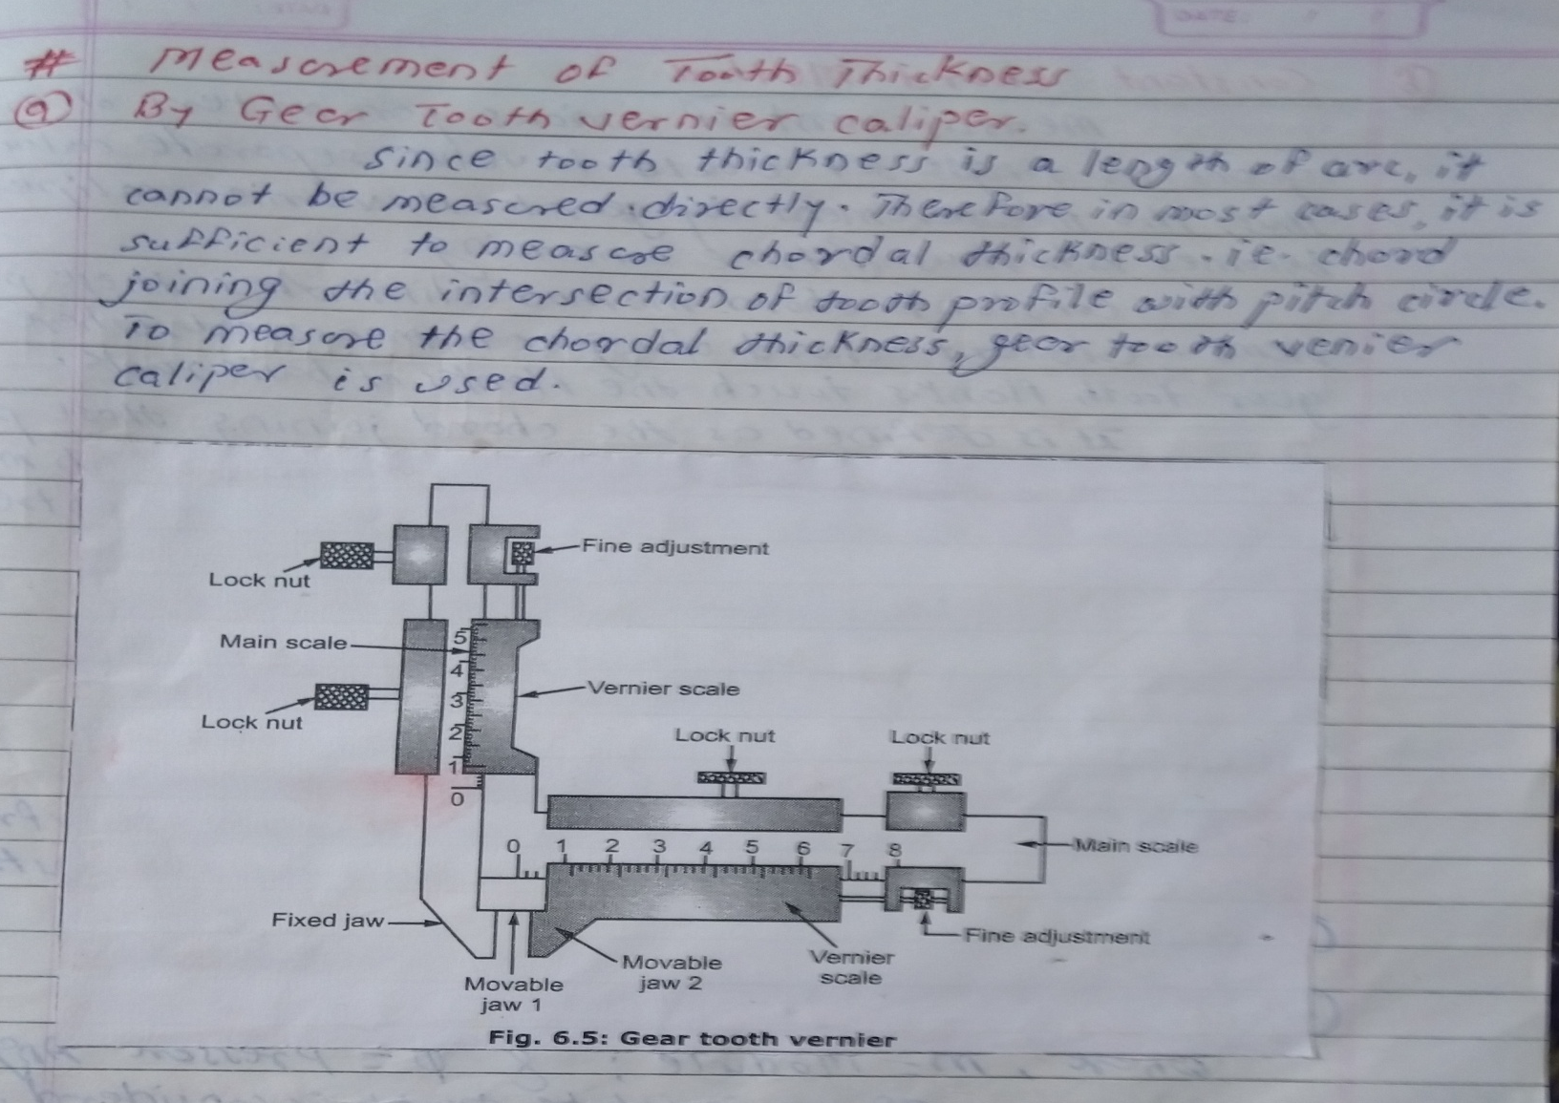
3.3b Measurement of Tooth Thickness by
Gear Tooth Vernier

Slide 7

3.3b Measurement of Tooth Thickness by
Gear Tooth Vernier

Slide 8
3.3c Optical Profile Projector
The profile projector is the optical instrument which consist of a light source, lens mirror etc.
Construction :- It consist of a light source which incident light on the mirror to create the profile of the object. Condensers are used to reduce the intensity of the light for avoiding fatigue to the operator. Table is made up of glass on which the job can be mounted. Magnifying lenses are used to magnify the image. The magnification upto 10X,20X,50X,100X,200X,
500X, 1000X can be possible.
Two micrometers are used to measure travelling of table in X and Y direction with least count of 0.01mm.The screen is made up of greenish colour glass which shows the magnified image. The screen consists of two perpendicular axis used for reference and a circular scale with marking of angle in degrees. Vernier scale can be used to increase the accuracy of measurement of angle.

Slide 9
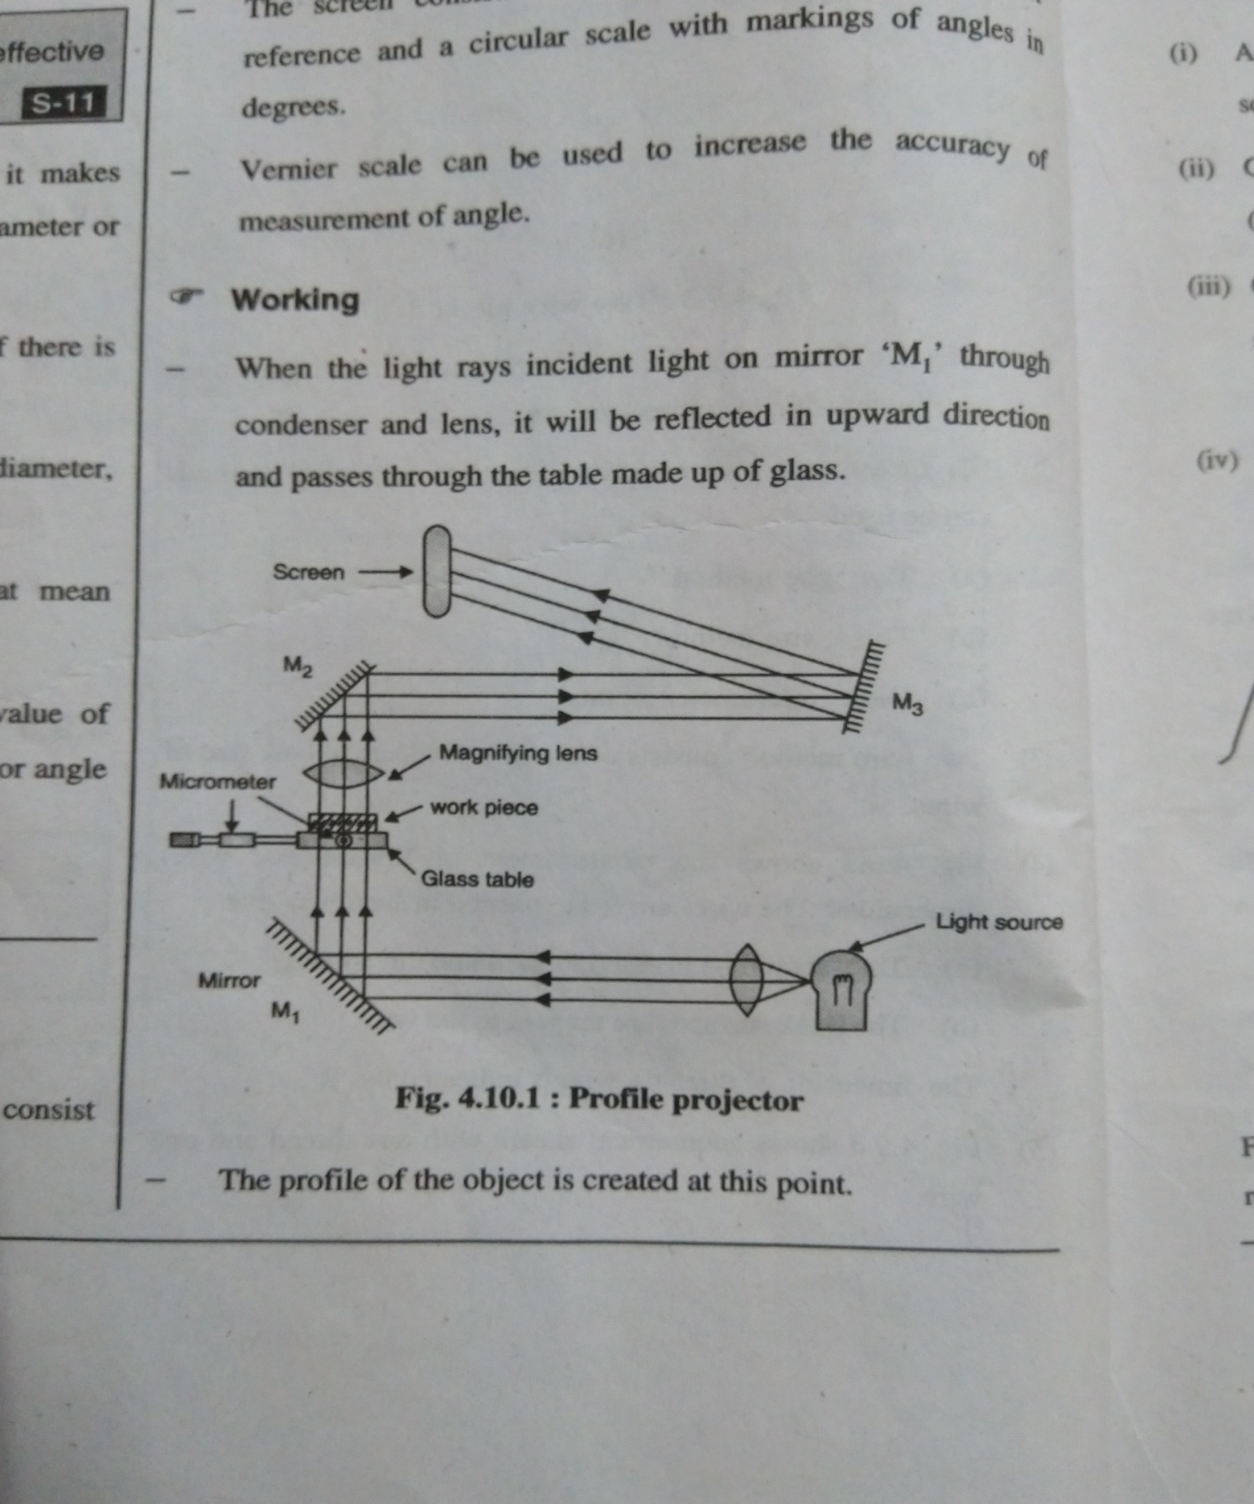
3.3c Optical Profile Projector

Slide 10
3.3c Optical Profile Projector
Working :-
When the light rays incident light on mirror ‘M1’ through condenser and lens, it will be reflected in upward direction and passes through the table made up of glass.
The profile of the object is created at this point .This will be magnified by using magnification lens. The magnifying image would be reflected on mirror ‘M2’ then to mirror ‘M3’ and finally visible on screen.

